Slide 1
CHAPTER 5.0
Project Commissioning, Start up and Operation

Slide 2
Project Commissioning
Project Commissioning is the process of assuring that all systems and components of a building, construction facility or industrial plant are designed, installed, tested, operated, and maintained according to the operational requirements of the owner or final client. By: Wikipedia
Commissioning & Start-Up is the last visible step of a project execution process. It moves the project from the “end of construction” to the “commercial operation” status. This phase covers initial and primary dynamic tests, including guarantee performance tests.

Slide 3
What is Commissioning ?
Commissioning is the process of planning, documenting, scheduling, testing, adjusting, verifying, and training, to provide a facility that operates as a fully functional system per the Owner’s Project Requirements.
The goal of the Commissioning Process is to enhance the quality of the delivered project by focusing the design and construction team on the Owner’s goals for a functional use of project

Slide 4
The breakdown for the five levels of technical commissioning include:
Level 1 — Design Phase
Develop detailed and comprehensive commissioning specifications and critique of design as it pertains to commissioning.
Level 2 — Construction Phase
Review and coordinate the application of the testing plan through the observation and documentation of all equipment and systems, ensuring function complies with the facility’s project systems requirements, objectives, and all contract documents.
Level 3 — Acceptance Testing
Providing on-site testing, commissioning, and performance testing. This is the most critical phase in the commissioning process. Capacity test critical equipment such as chillers, air handling units, boilers, and pumping systems. Includes testing internal failures and recovery tests, and reporting and annunciation of alarms and abnormal conditions.

Slide 5
Level 4 — Integrated System Testing
At this level, the interaction between the infrastructure facilities and plant systems with one another shall be demonstrated under both normal and abnormal operating conditions. E.g Under this level of commissioning, we will validate how the site infrastructure, such as chillers, pumping systems, heating plant, air handlers, and electrical systems will likely perform as a system over the next 60 months.
Level 5 — Warranty Phase (DLP)
One year functional retesting of (infrastructure) all equipment and systems within the commissioning contract. Re-visit any outstanding issues in accordance with the original and seasonal commissioning. Facilitate the required opposite season or deferred testing and deficiency corrections. Final testing results, documentation, and reports shall be incorporated into the existing commissioning record as well as the current O&M manuals. Provide a retro commissioning plan of systems for future implementation.

Slide 6
Commissioning of
Building Projects
Building commissioning is the process of verifying, in new construction, all (or some, depending on scope) of the subsystems for mechanical, plumbing, electrical, fire/life safety, building envelopes, interior systems (example laboratory units), cogeneration, utility plants, sustainable systems, lighting, wastewater, controls, and building security to achieve the owner's project requirements as intended by the building owner and as designed by the building architects and engineers.

Slide 7
Commissioning of
Road Projects
Road commissioning is the process of verifying, in new construction, all (or some, depending on scope) of the subsystems for Design Speed, Horizontal /Vertical Curves, Sign/Signals, life safety, Geostatic treatment, cogeneration, utility plants, sustainable systems, traffic safety, controls, and road security to achieve the owner's project requirements as intended by the road owner and as designed by the road designer and engineers.

Slide 8
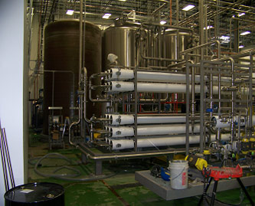
Commissioning of
Electro Mechanical Projects
Central Plant Heating and Cooling Systems
Boiler Design
Chiller Design
Cooling Tower Design
Pumping Systems
Heating water, chilled water and condenser
Water Piping Systems
Retail Constant Volume Systems
Residential Heat Pump Systems
Temperature Control Systems
Geothermal Systems
Snow Melt Systems
Radiant In-Floor Heating Systems
Computer Room In-Rack AC Systems
Existing System Renovations and Remodels
Lab Exhaust Fan Systems

Slide 9
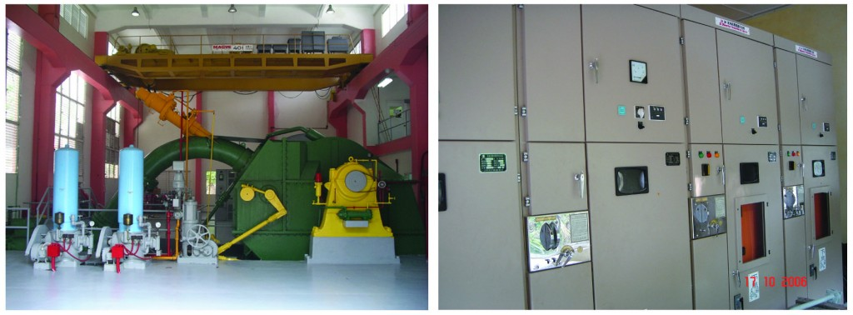
Commissioning of
Hydro Mechanical Projects
With a very strong team of experienced engineers and technicians, provides testing and commissioning services to various types of power systems, including substations.
With key experience in the testing and commissioning of switchgears, power transformers, protection and control systems, substation auxiliary equipment, fiber optic cable splicing and generation equipment, is committed to providing benchmark services to its clients.

Slide 10
Commissioning of contd..
Hydro mechanical Projects
Testing & Commissioning for:
Power Systems
Generation Equipment
Transformer
High Voltage
Fiber Optic
Transmission Line/ Underground Cable
Maintenance Solutions

Slide 11
Procedure of Commissioning
Commissioning Plan
The commissioning plan is first developed in the pre-design phase/ design phase / design completion/construction phase
Details of systems tests and procedures, assembly specific checklists, testing and documentation responsibilities are incorporated in construction phase commissioning plans

Slide 12
Commissioning plans contains the following:
General Project Information
Overview and Scope of the Project Commissioning
Listing of Equipment and Systems to be Commissioned
Commissioning Protocols and Communications
Commissioning Process, including Team Responsibilities
Commissioning Schedule
Commissioning Documentation
Appendices
Testing and Inspection Plans
Inspection, Functional and Performance Test Procedures
Construction Checklists
Performance Testing Procedures and forms
Issues Logs

Slide 13
Commissioning Planning contd..
Establish Testing and Inspection Plans:
Develop Commissioning Specifications
Determine Special Testing Needs

Slide 14
Examples
template _ Commissioning_Plan_ building (1-05).pdf
model-commissioning-plan (sample).pdf
PROJECT_STANDARDS_AND_SPECIFICATIONS_general_commissioning_procedures_Rev01.pdf
04_ModelPlan_ConstPhase_PECI.pdf

Slide 15
Project Start up
Project Start Up is a short phase between the project planning and execution. it is responsible for successful transition of a project from a state of underlying concepts and plans to a state of practical execution.
Overview
Project startup is a very short phase of the project management cycle. It is a transition step between project planning and execution. While it is a short step, important events occur, including:
Base lining of the project plan with management sign-off
Commitment of resources by agency management
Creation of a project database
Project Kick-off meeting
The project startup is a significant event in the life of a project. The project team must be formed, resources must be brought together, and the plan must be finalized.

Slide 16
Project Startup Steps.
Establish the Plan Baseline
The first step of the project start-up stage is to finalize the project plan and establish a baseline.
Baseline refers to a plan that has been placed under configuration management so that changes to the plan are made under the change control process as discussed in Configuration Management of Project Planning and Project Execution.
Fine Tuning the Plan
A final tuning of the project plan typically occurs during the project start-up phase.
This fine tuning consists of incorporating changes that result from management review or, in the case of a project that involves procurement, changes that result from contract negotiations.
Only minor changes can be made to the plan at this time—major changes require a return to the project planning phase.
Minor changes are defined as a refinement of activities, the addition of oversight and quality activities, and alterations to the schedule. Any change that results in more than a 5% increase in cost or schedule should be viewed as a major change.
Plan Approval
During the start-up process, the plan is finalized by the Steering Committee. At this point, resources are committed and plans are made to quickly move to the execution phase.
The final project plan approval varies depending on the project and may require approval from the following: the project manager, Steering Committee, user management, If the effort includes contractors, it may be necessary to get the prime contractor and procurement to sign off on the plan.
The Steering Committee approval represents a commitment to implement the project as described in the plan. This is a commitment to scope, schedule, and budget.

Slide 17
Start-Up Check List
A good way to ensure that all start-up tasks are completed prior to actually starting the project is to use a start-up check list. The check list can be used by others to ensure that the tasks necessary to start the project are completed.
The Start-Up Check List is a combination of an action list and a tool to verify that necessary steps have been completed. This list addresses the following activities:
Tracking and monitoring processes
Defining what will be tracked and monitored and the format for this information
Reviewing the schedules and formats
Reviewing the configuration management system and ensuring the assignment of this responsibility
Reviewing the change control process and ensuring that it is institutionalized
Determining how issues will be raised in the project and who will track their resolution
Defining the risk management process
Defining the change management process

Slide 18
Defining the project environment
Completing the project baseline
Identifying project standards and tools
Identifying and refining the roles and responsibilities of the project team members
Setting expectations for the project team
Defining all the project control processes
Obtaining and allocating resources
Initiating project kick-off meeting
The project manager owns the start-up check list, although in most projects, the full team provides input. In large projects, the development and completion of the start-up check list might be assigned as an administrative support function.

Slide 19
Preparation Needed for Project Start Up
Understand and communicate project objectives and goals
Early and timely decisions
Analysis of risks and preparedness
Early planning - plan just right and re-plan if necessary
Realistic estimate and programs
Priority and commitments - CPM
Motivation
A good design that considered all alternatives
Committed project teams

Slide 20
Good communication systems
Capable project managers
Delegation of authority to the capable ones
Appropriate contract strategy and type of contracts
Selection of capable contractor and consultant
Minimum time loss in early stage
Fair pricing and variations
Appropriate training
Clear and concise contract documents, specification and BOQ
Past experiences

Slide 21
Place and value for everybody in the project
Appropriate control
Minimum change during implementation
Reward success and assist failures
Reward team as well as individuals
Co-relate any change with time and money
Honesty and reliability of team
Consideration of health and safety
Appropriate information technology
Feedback on what is implemented

Slide 22
Start up process
Goal statements and more or less detailed plan documents, considering some of the other focus areas within project start-up.
Project basis at the time – The demands & Supply to solve, and which terms and assumptions does the project build on? The project manager must go back to the parties that have been involved in the project prior to the start-up, to clarify the current basis and the project mandate.
Uncertainty – Which opportunities and risks do the project face, and which flexibility exists? The uncertainty is large at such an early stage.
Stakeholders – Which internal and external stakeholders must the project be aware of, and what strategies should the project manager establish to handle these stakeholders?
Project goals – The project manager must have a clear understanding of the goals of the project before he decides how to go further and who to go among the team with.
Organization – What sort of competence and skills are needed to solve the project? The questions of organization touch many different problems.
Systems for planning and control – What is the scope of work and what is the time and cost frames of the project? When project start-up is terminated, it should be documented what the deliveries from the project.

Slide 23
Start up records
The project entailed comprehensively inventorying the foundation’s electronic records, establishing a digital archives infrastructure, developing capacities for processing removable media as well as procedures for incorporating obsolete and obscure file formats, creating web archives, and preserving significant e-mail correspondence.
The project also developed detailed workflows for incorporating born-digital records into the repository, including complex file formats such as video, 3-dimensional models, CAD drawings, and more.

Slide 24
Start up reports
Prepare Start up report using Microsoft Word, issues will relate to the Start up process, write briefly, Focus on the project, Concentrate on Objectives of the project
Project Proposal Format
Title of the Project
Origin
Beneficiary
Partners
Duration
Budget
Goals
Objectives
Activates
Also the documents needed
BOQ
Drawings
Specification
COC
Checklist
Project Proposal
Pre-feasibility
Feasibility

Slide 25
Project Operation
Project operations are the ongoing execution of activities that produce the same output, or provide a repetitive services, are used to run regular business models, achieve the goals of the business, and sustain the business, are different as opposed to Projects, which are known for their uniqueness, are permanent in nature, and their only constraint is to make profit for the organization.
It defines how you will operate in practice to implement your action and monitoring plans – what your capacity needs are, how you will engage resources, how you will deal with risks, and how you will ensure sustainability of the project’s achievements.

Slide 26
Presentation regarding Commissioning plan
GROUP DISCUSSION AND PRESENTATION
Group Discussion for provisions of PPA regarding Project Commissioning

Slide 27
Handing over to Operation Department
Unusual need for operator training
New process or controls technology
Handling of Hazardous materials
Difficult or complex interface with Operations
Seepage monitoring and mitigation related to start-up
HSE issues associated with facility start up sequence
Interfaces for Handover to Operations
Loop checks
Safety walk-through
Punch list close-out for residual construction items

Slide 28
Handing over to Operation Department
Training for Operation, Maintenance, Start-up, Emergency response & Safety
Strategy for development of Local operator workforce
Description of the General Operations philosophy relative to degree of automation, staffing levels, staff rotation, training, contracting strategy, etc.
Operations input into engineering design
Transition planning for handover from Project to Operations

Slide 29
Project Operation Plan
What Is an Operational Plan?
It defines how you will operate in practice to implement your action and monitoring plans – what your capacity needs are, how you will engage resources, how you will deal with risks, and how you will ensure sustainability of the project’s achievements.
An Operational Plan does not normally exist as one single standalone plan; rather the key components are integrated with the other parts of the overall Strategic Plan.

Slide 30
Project Operation Plan
Human and Other Capacity Requirements – The human capacity and skills required to implement the project & current and potential sources of resources.
Financial Requirements – The funding required implementing the project, current and potential sources of these funds & most critical resource and funding gaps.
Risk Assessment and Mitigation Strategy : What risks exist and how they can be addressed.
Estimate of Project Lifespan, Sustainability, and Exit Strategy – How long the project will last, when and how will exit project, and how will ensure sustainability of project’s achievements.

Slide 31
Monitoring of Operation
Monitoring and controlling is the management function of comparing the actual achievements with the planned ones at every stage and taking necessary action, if required, to ensure the attainment of the planned goal.
Effective project control consists of a process that:
Identifies potential hazards well in advance of their occurrence
Evaluate impact of hazards where possible and work out mitigation measures
Constant surveillance to create no surprise condition

Slide 32
Major elements to control are:
Control of progress, time, quality of works, performance, cost, budget, accounting system etc.
Effective control system shall include:
Through planning of the work
Good estimating of time, labor and costs
Clear communication of the scope of required task
Budget and authorization of expenditure
Timely accounting of physical progress and cost
Periodic re-estimation of time and cost
Comparison of actual progress and expenditures to schedules and budgets

Slide 33
Operation Reporting
Prepare operating report using Microsoft Word.
Describe the Human Recourse Management
Material Management
Schedule of Work
Cash-flow
Health and safety
Focus on the project
Concentrate on Objectives of the project

